Slide 1
CSC 413[01] – Game Design
By: Aleksandr Kibis

Slide 2
Topics
WingMan Demo
Class Diagram
Changes
Class Examples
Sound
HUD
Explosion
Tank Demo
Challenges

Slide 3
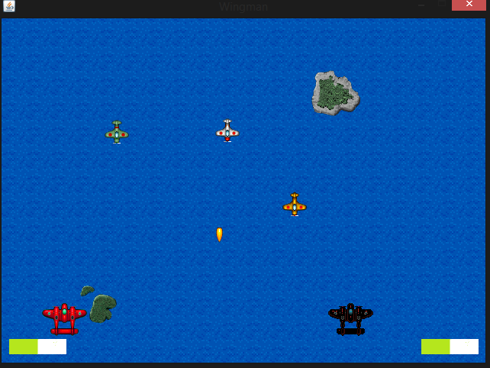
Demo

Slide 4
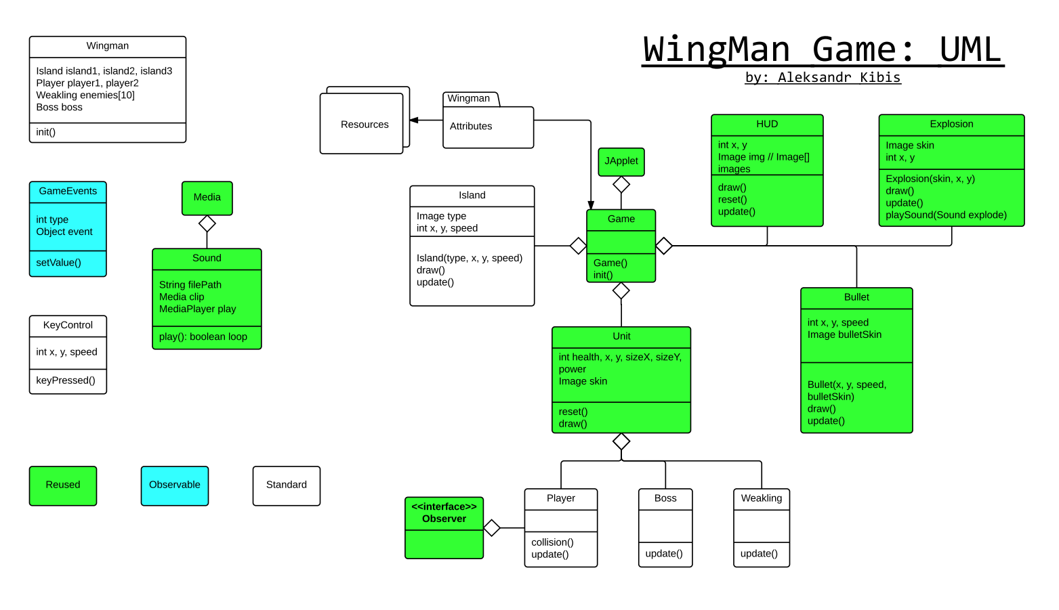
Original Design

Slide 5
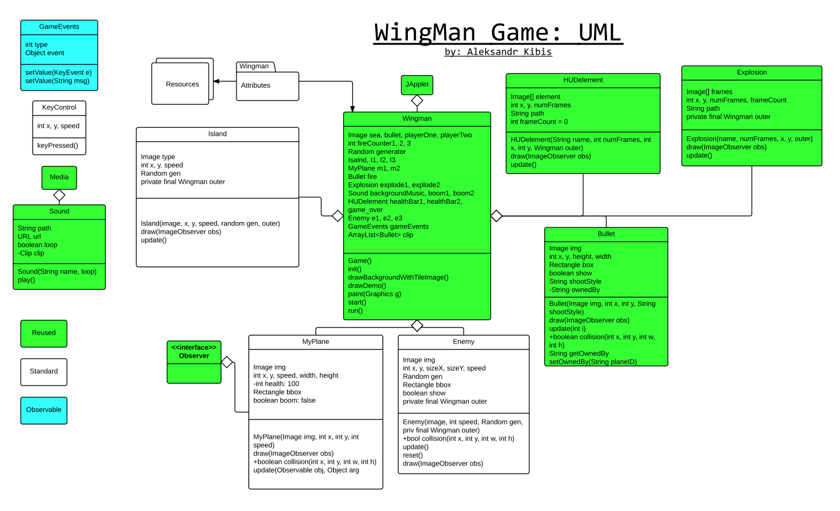
Updated Design

Slide 6
New Classes
Sound
HUDelement
Explosion

Slide 7
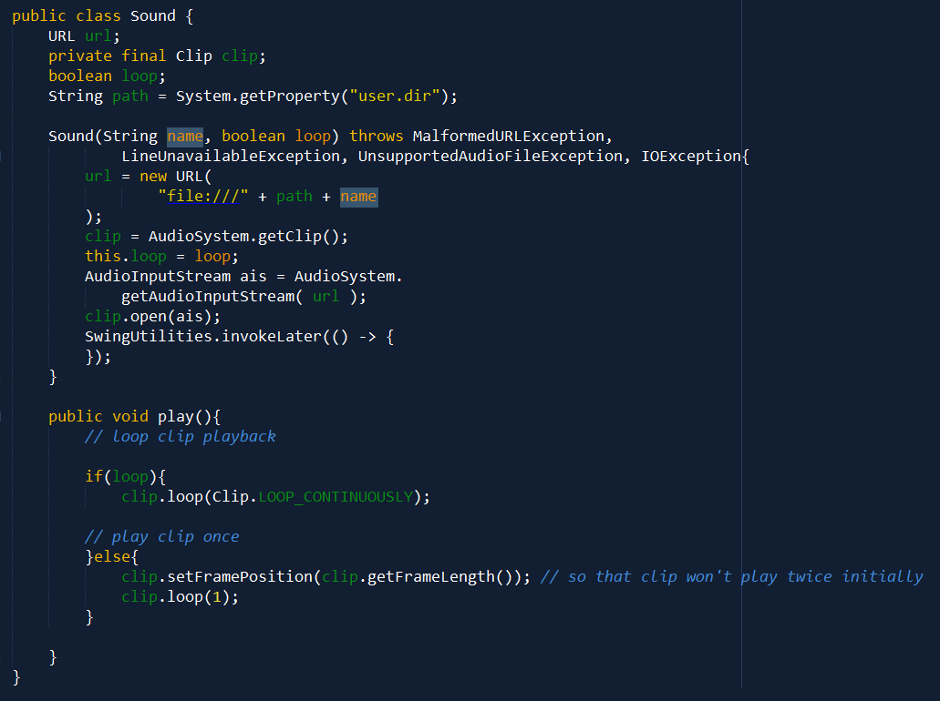
Sound

Slide 8
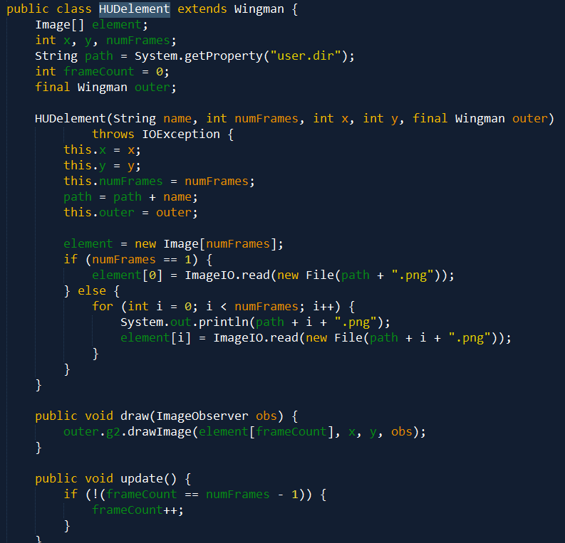
HUDelement

Slide 9
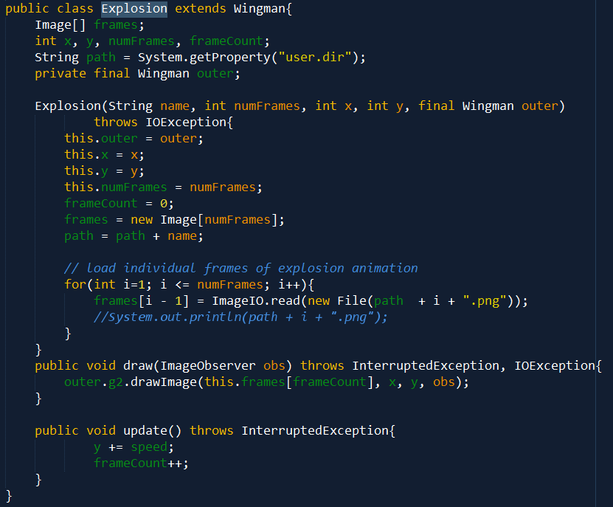
Explosion

Slide 10
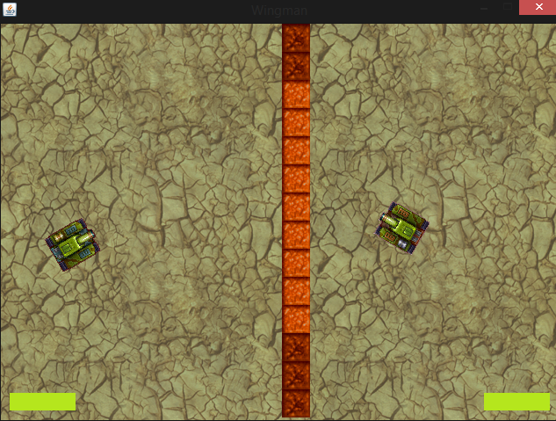
Tank Game Demo

Slide 11
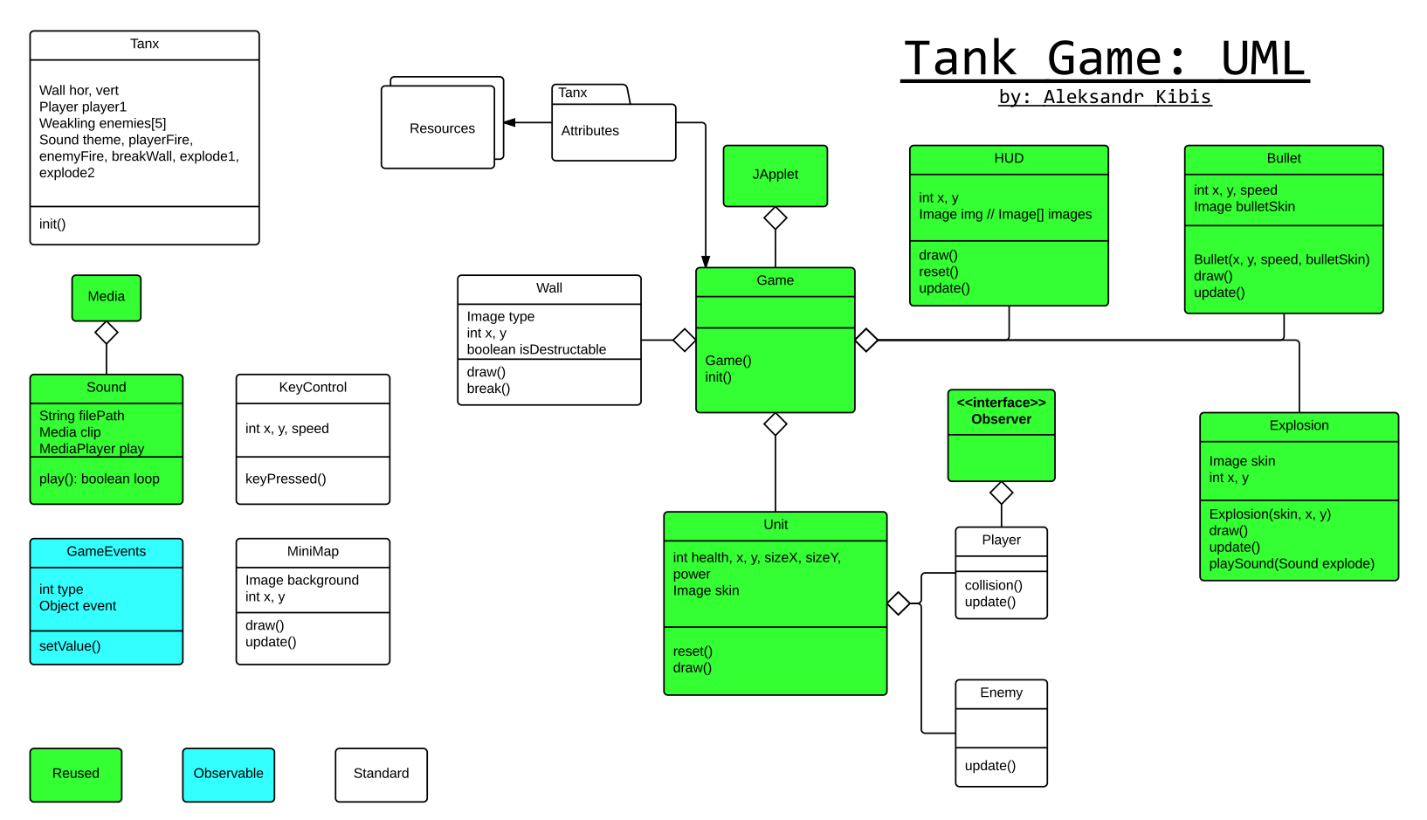
Original Design

Slide 12
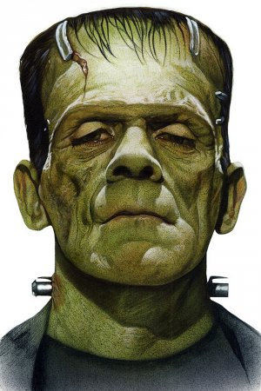
Changes so far…
Bullet class modified
Fire direction added to constructor
Suggestion: create Tank Bullet class which extends bullet
Island + Enemy = Wall!
Skins and Sounds

Slide 13
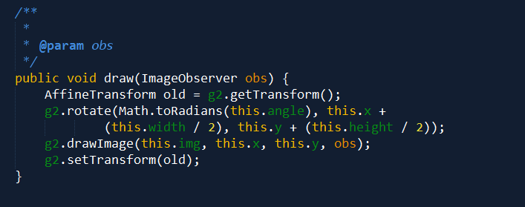
Image Rotation

Slide 14
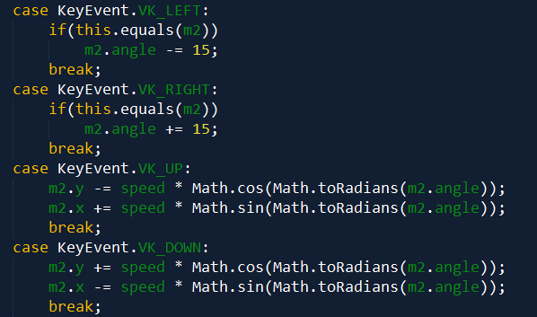
Key Mapping

Slide 15
Challenges
Class separation
Observer/Observable
Java audio handling
Reusability

Slide 16

The End!

